Slide 1
Demystifying Parallel and Distributed Deep Learning: An In-Depth Concurrency Analysis
TAL BEN-NUN and TORSTEN HOEFLER, ETH Zurich
Presenter: Xupeng Miao, Zhipeng Zhang

Slide 2
Outlines
Background
Trends
Supervised, Unsupervised and Reinforcement Learning
Single-Node Deep Learning
Distributed deep learning

Slide 3
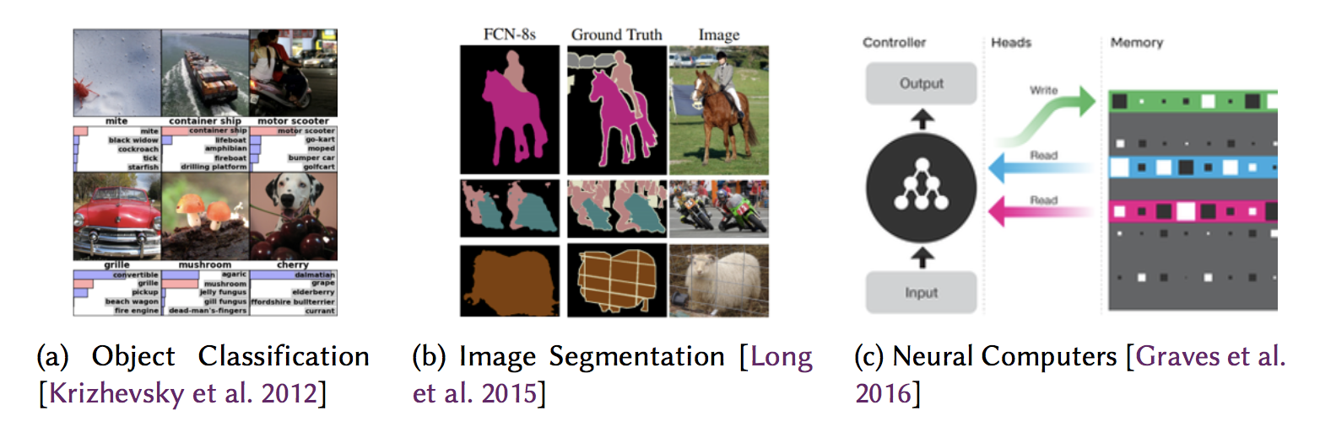
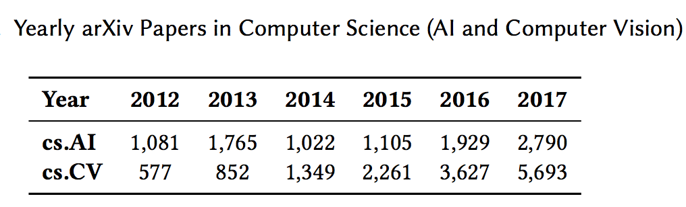
Trends: Research

Slide 4
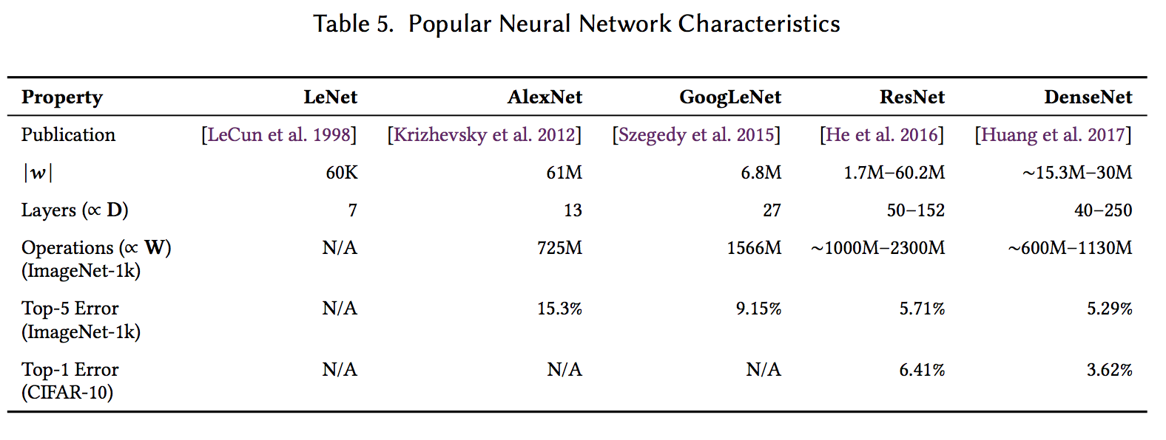
Trends: Model Size

Slide 5
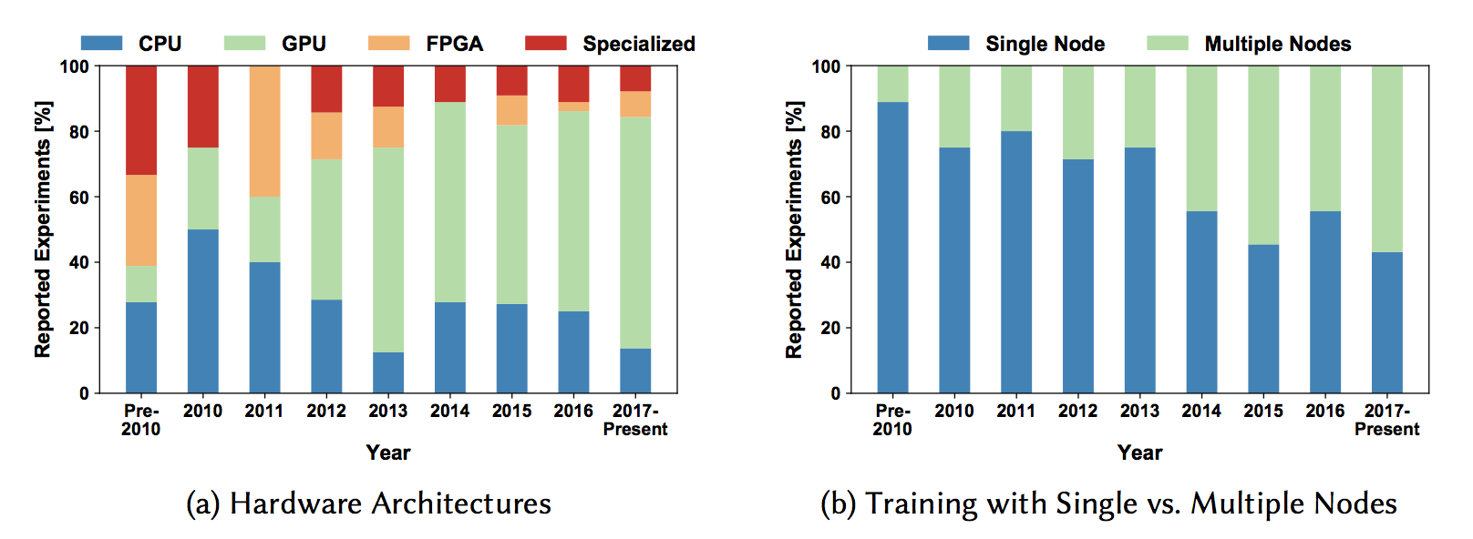
Trends: Hardware and multi-node

Slide 6
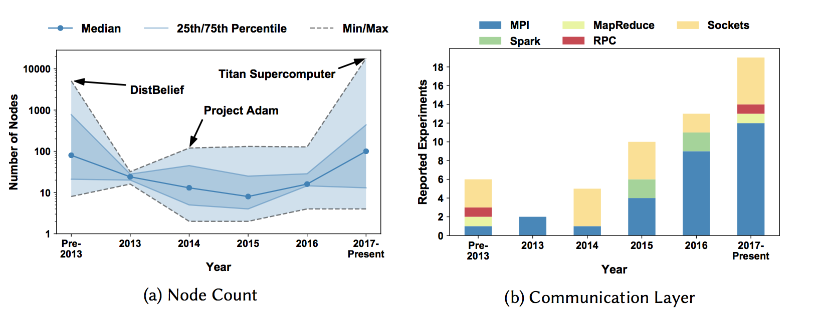
Trends: Node count and communication

Slide 7
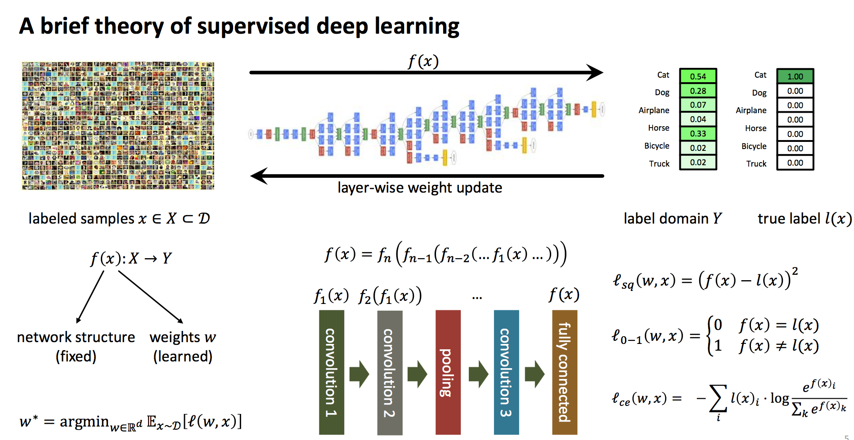

Slide 8
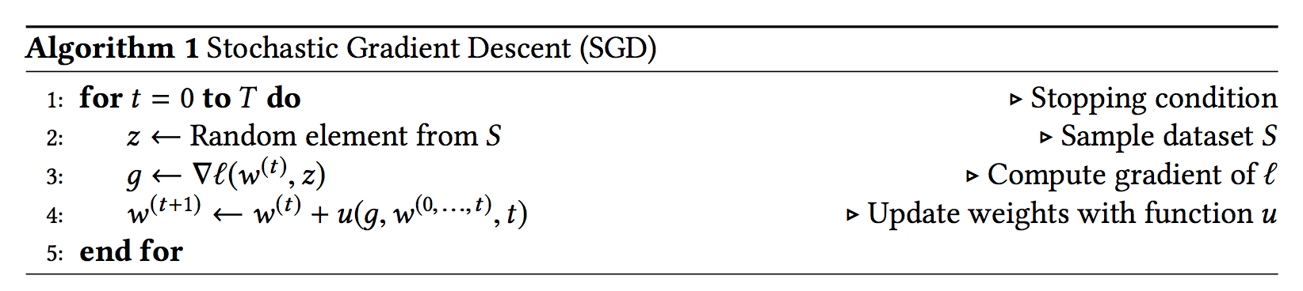
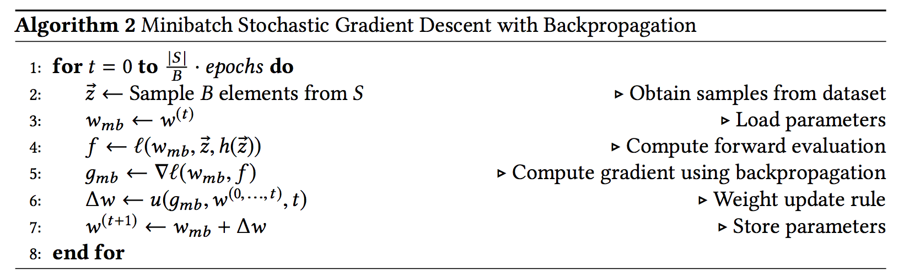
SGD and Mini-batch SGD

Slide 9
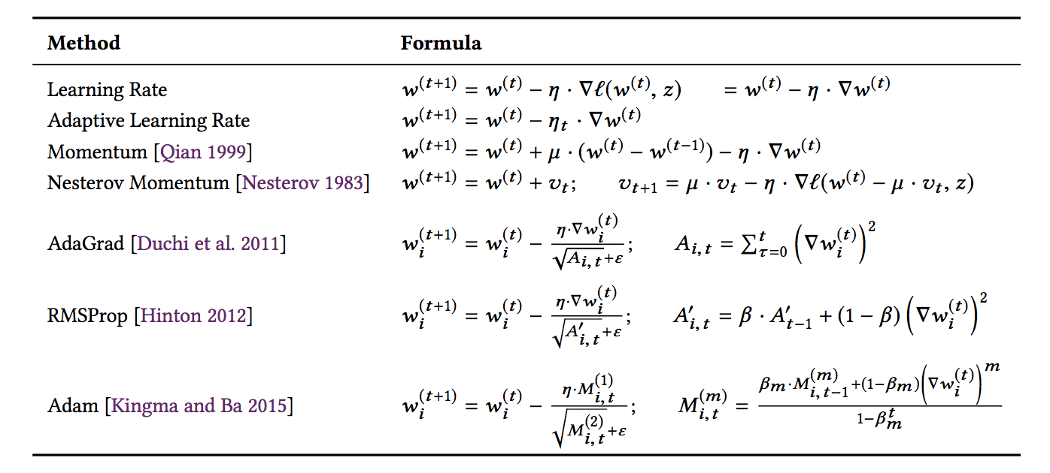
Popular Weight Update Rules

Slide 10
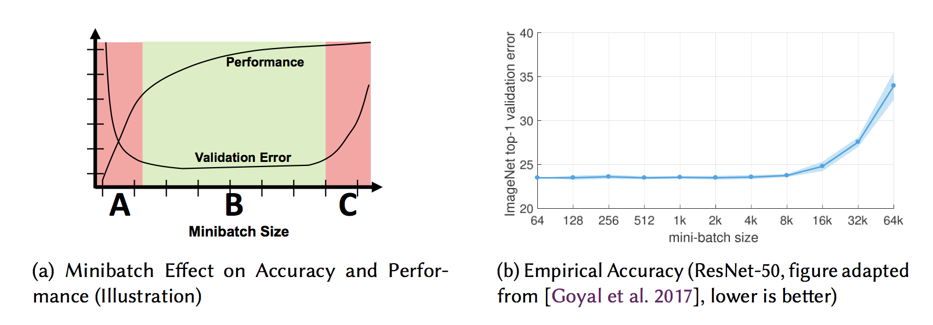
Mini-batch Size Effect

Slide 11
Outlines
Background
Single-Node Deep Learning
Deep Neural Networks
Layer Computation
Optimization Methods
Hyper-Parameter Search
Architecture Search
Distributed Deep Learning

Slide 12
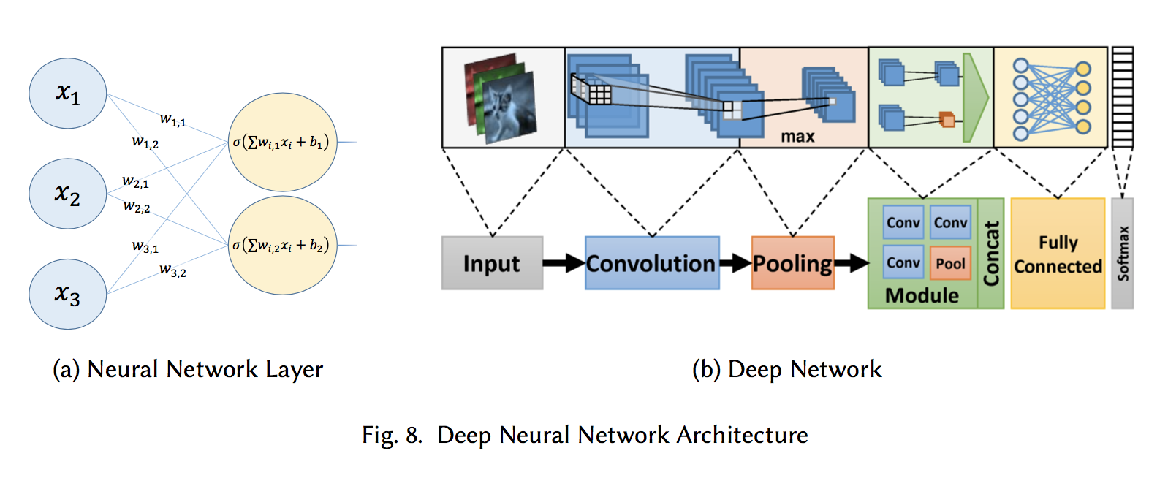
Deep Neural Networks

Slide 13
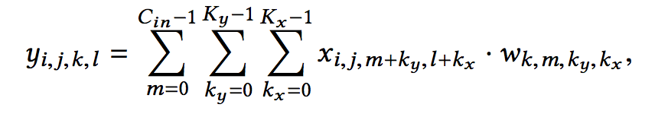
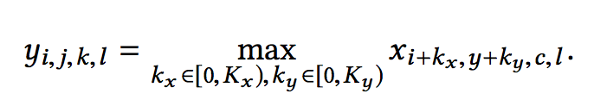
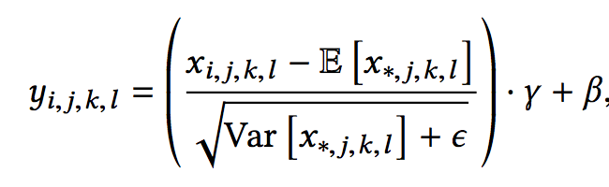
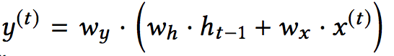
Layer Computation
Convolution Layer
Pooling Layer
Batch Normalization Layer
Recurrent Layer

Slide 14
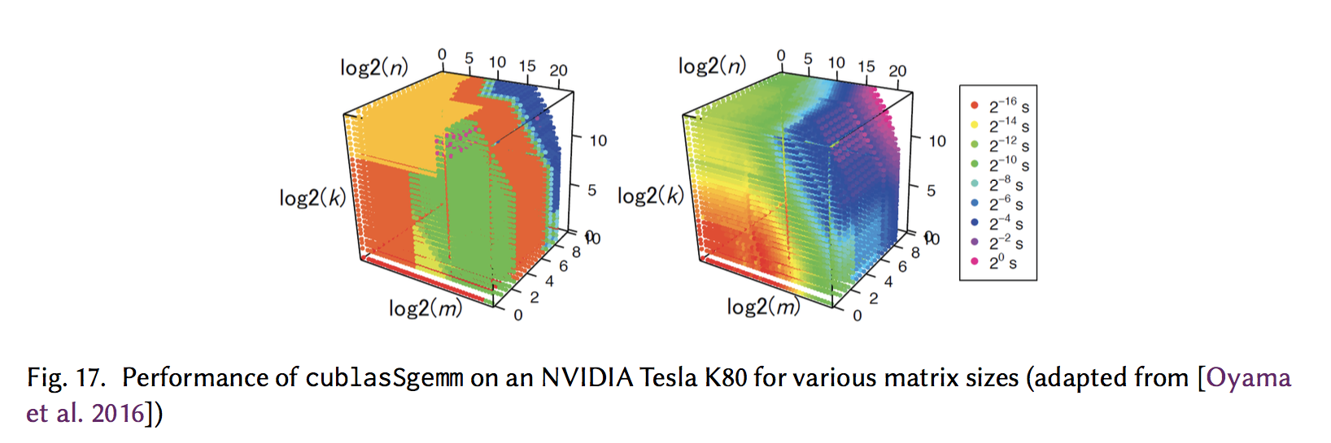
Layer Computation

Slide 15
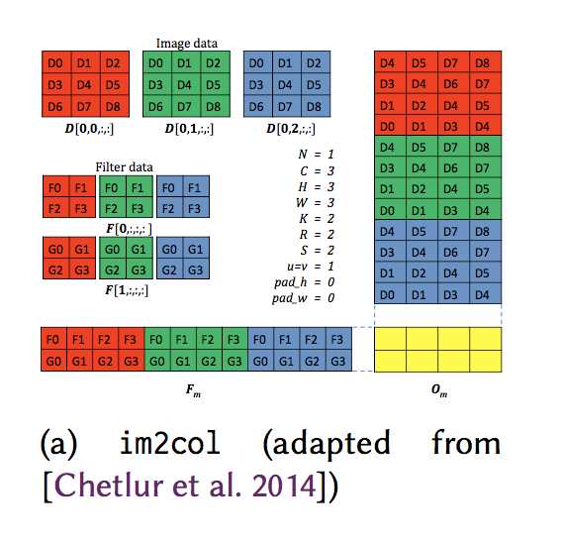
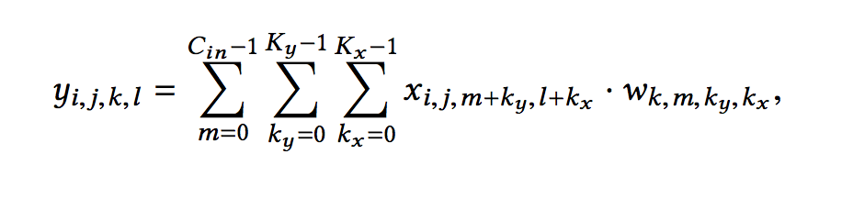
Layer Computation

Slide 16
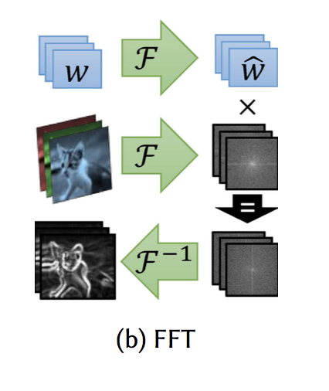
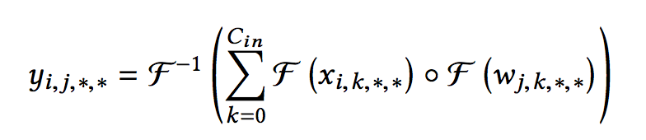
Layer Computation

Slide 17
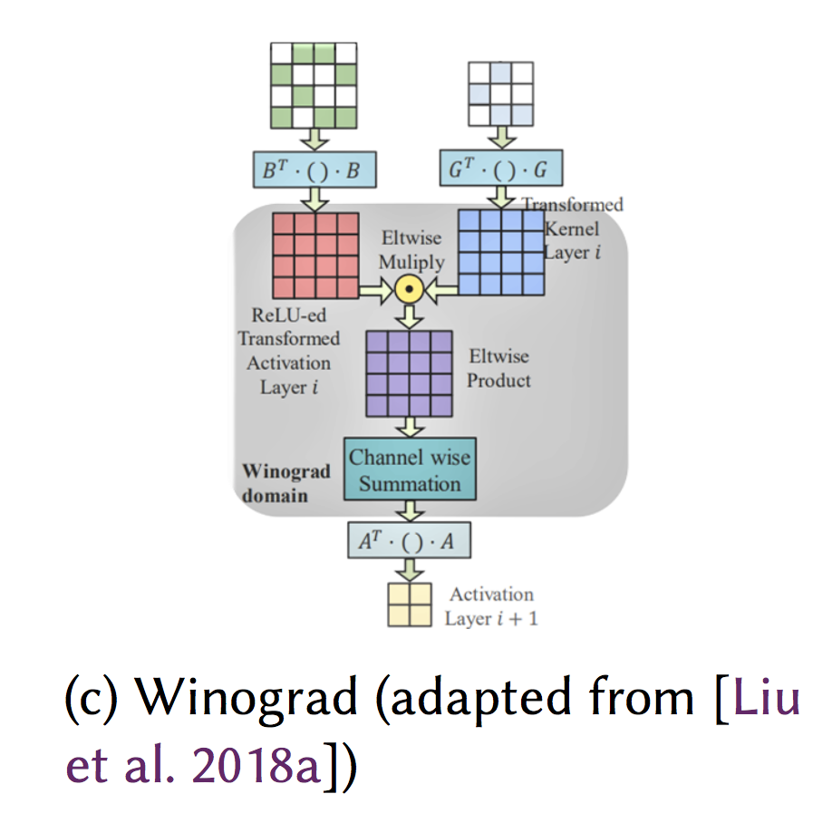
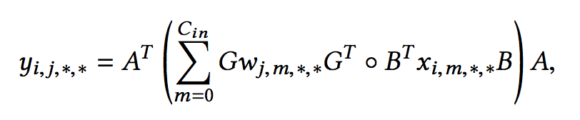
Layer Computation

Slide 18
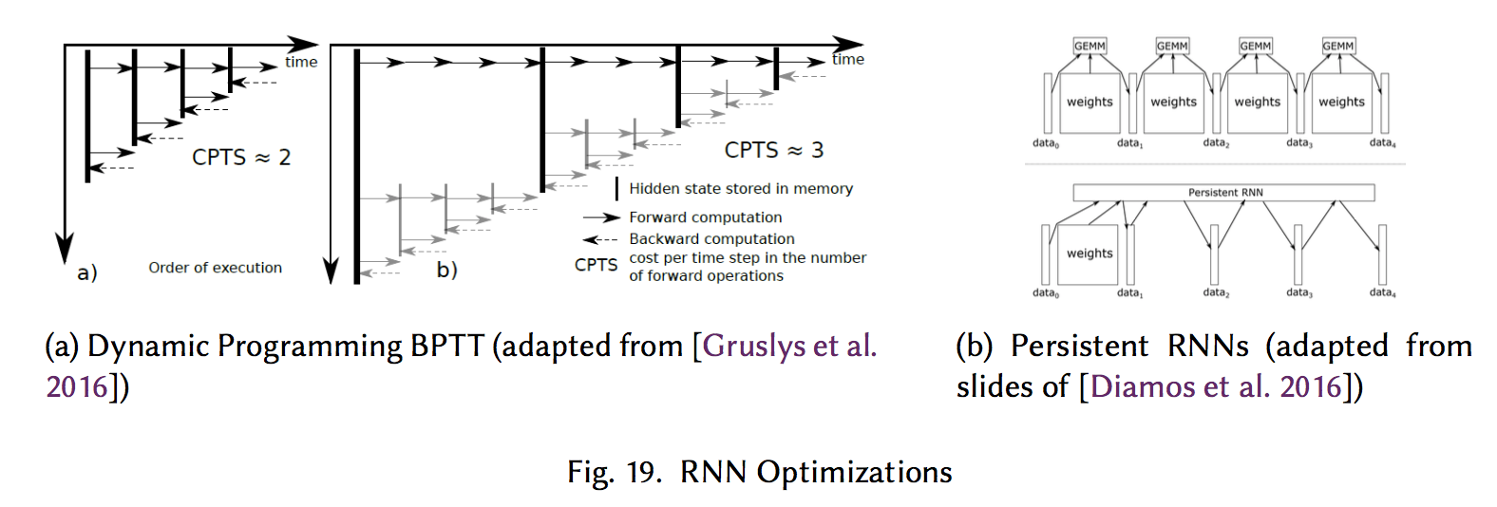
Layer Computation

Slide 19
Optimization Methods
Batch methods
CG
L-BFGS
Hessian-free second-order optimization
Other optimization algorithms
Gradient-free evolutionary algorithms

Slide 20
Hyper-Parameter Search
Grid search
Bayesian optimization
Predictive analysis of the learning curves
Sampling the hyper-parameter space with Compressed Sensing
Metaheuristic optimization

Slide 21
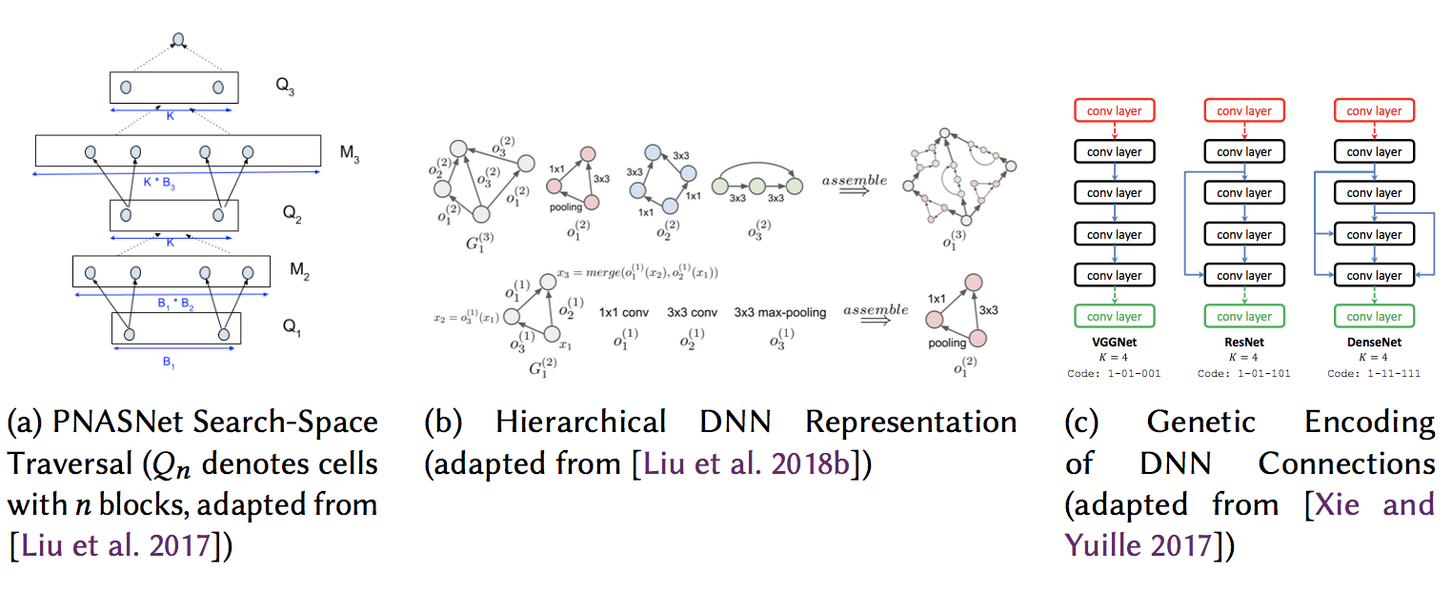
Architecture Search

Slide 22
Outlines
Background
Single-Node Deep Learning
Distributed Deep Learning
Parallelism (data paralellism, model parallelism, pipeline, hybrid)
Centralization (Decentralized vs. Centralized)
Compression (Full precision vs. Low precision)
Model consistency (Asynchronous vs. Synchronous)
Model consolidation (ensemble learning, model average)

Slide 23
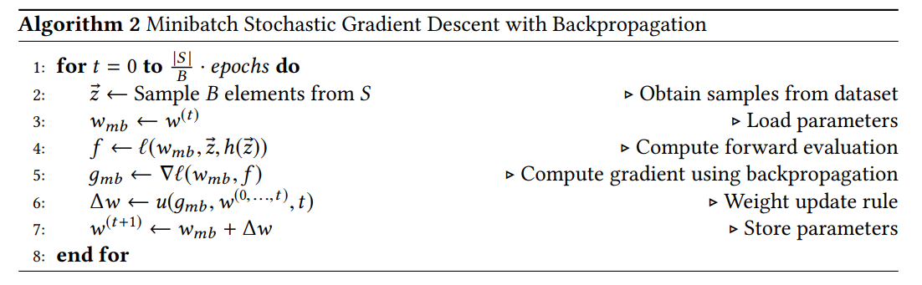
Background

Slide 24
How to distribute the jobs?

Slide 25
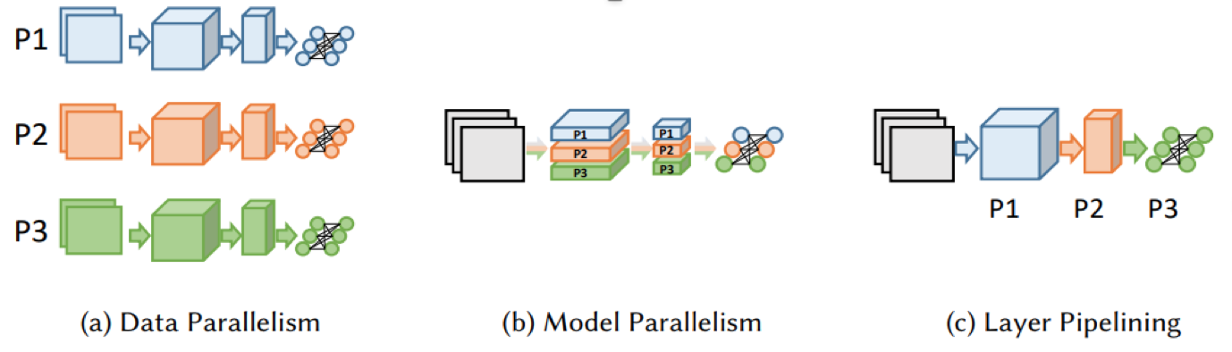
Ways of parallelism
Data parallelism: partition input data
Model parallelism: partition neurons inside one layer
Pipeline: partition layers
Hybrid

Slide 26
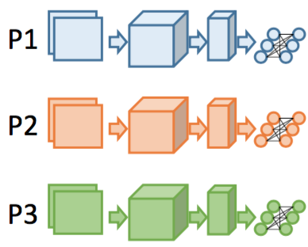
Data parallelism
Partition data in a minibatch and feed them to different machines.
Characteristics:
One machine has to hold the whole model.
Communication in aggregating gradients and batch normalization
Scalability is bounded by batch size.

Slide 27
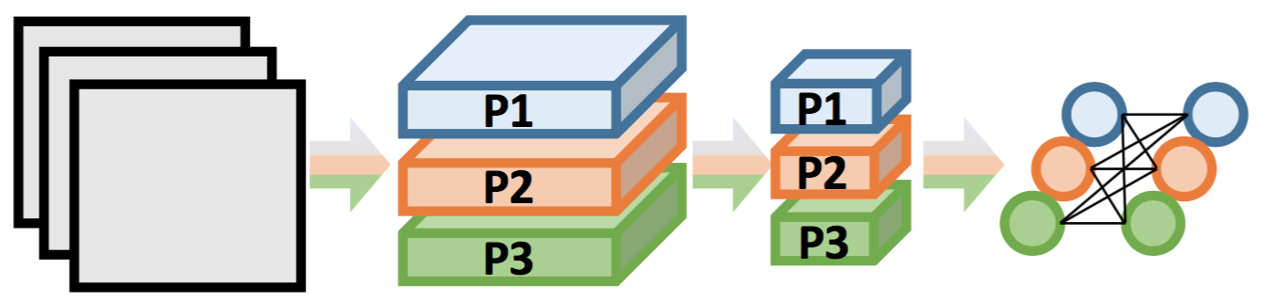
Model parallelism
Partition neurons inside each layer
Characteristics :
Smaller memory overhead for each machine
All-to-all communication after each layer

Slide 28
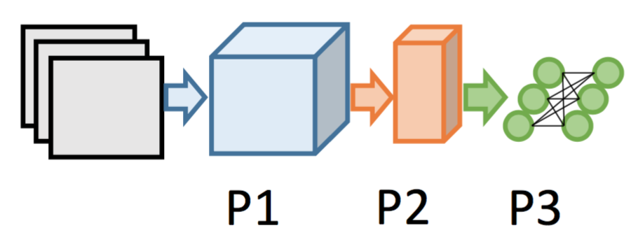
Pipelining
Partition layers
Characteristics :
Smaller memory overhead for each machine
Communication after each layer

Slide 29
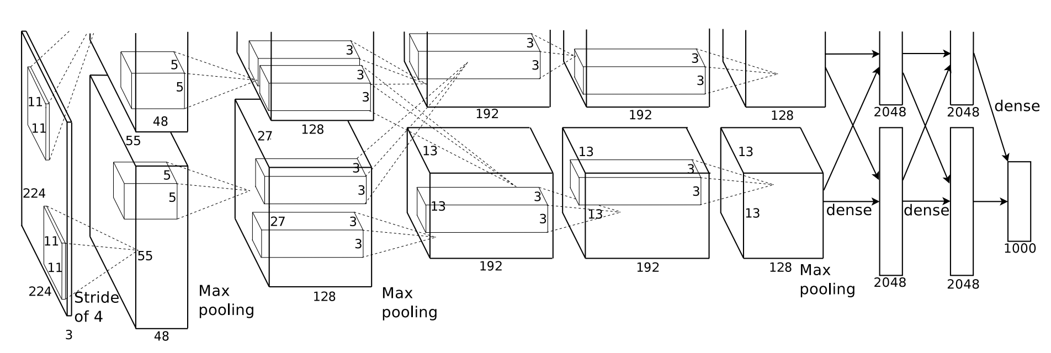
Example of Hybrid -- AlexNet
Best speedup using Model parallelism or Data parallelism with 4 GPUs: 2.25X.
Best speedup using Model parallelism for Conv, Data parallelism for FC using 4 GPUs is 3.1X.

Slide 30
How do the jobs cooperate each other?

Slide 31
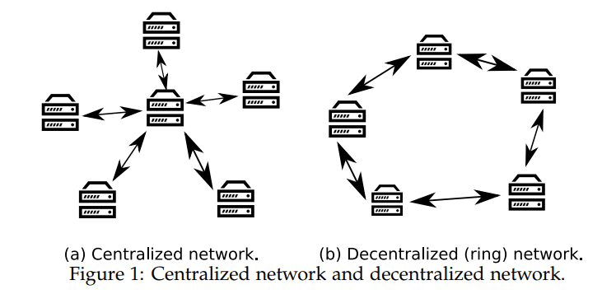
Centralization (Decentralized vs. Centralized)
Heterogeneous environment: network topology, bandwidth, latency, fault tolerance, etc.

Slide 32
Compression (Full precision vs. Low precision)
Motivation: communication can be expensive; smaller models maybe needed.
Solutions:
For gradients: stochastic roundding, quantization, sparsification, sketch
For model: quantization, sparsification, distillation

Slide 33
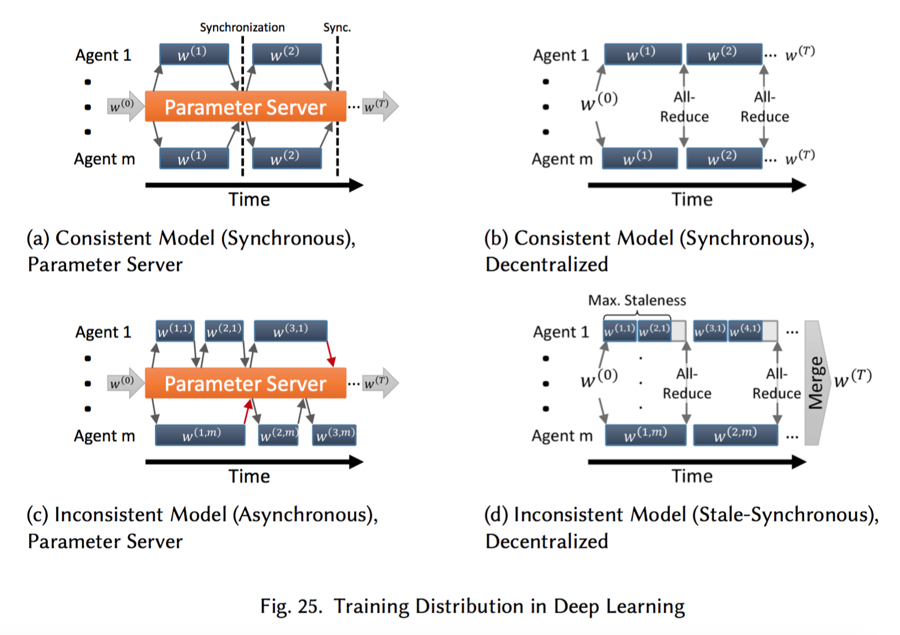
Model consistency (Async vs. Synchronous)
When others can see your update?
HOGWILD!
SSP
…

Slide 34
Model consolidation
Ensemble learning
Model averaging
Parallel SGD
EASGD
…

Slide 35
Summary of distributed (DL/ML) systems
Data parallelism
Model parallelism
Pipelining
Hybrid
Async, Sync
De-, centralized
Low precision

Slide 36
Possible directions (mentioned in the paper)
Smaller model for mobile devices.
Energy-efficient hardware is needed, like FPGA, TPU, other ASICs.
An ease of use ML system is important:
AutoML: architechture search, hyper-parameter search

